Slide 1
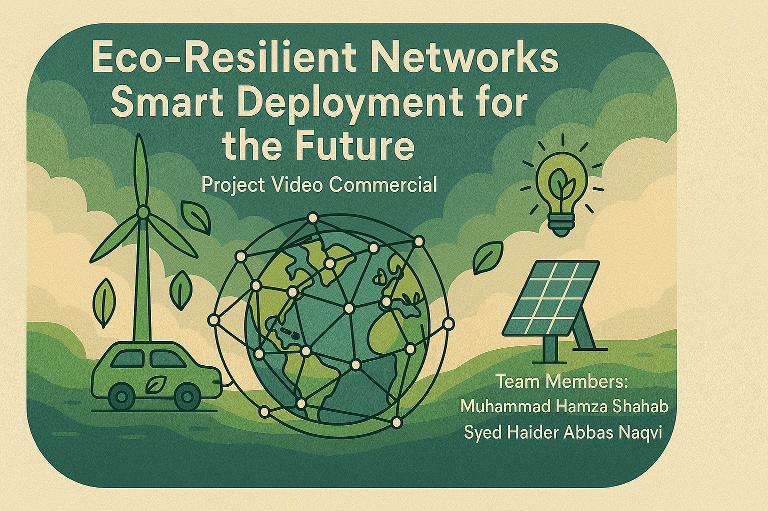

Slide 2
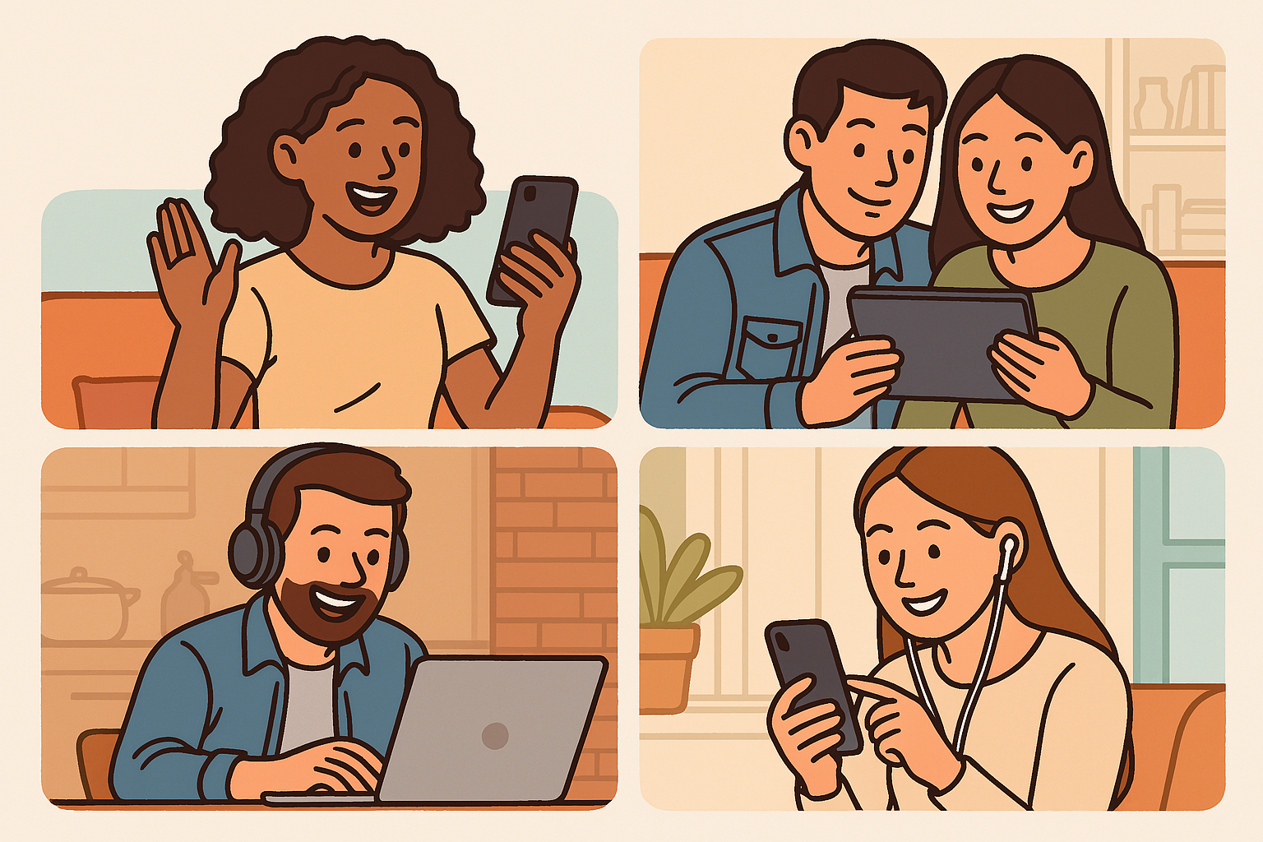

Slide 3
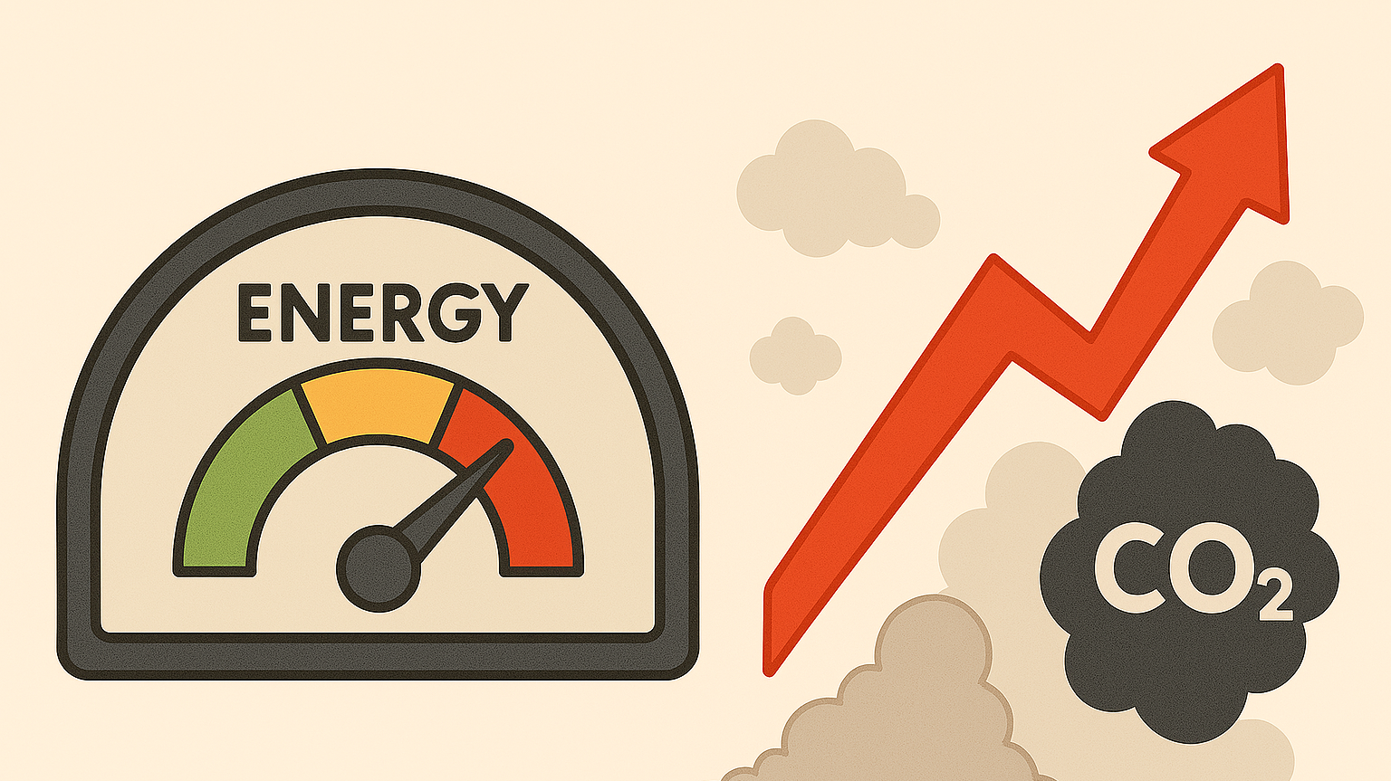
Notes:
We identified key gaps in the current technology: a lack of focus on sustainability and limited optimization capabilities.

Slide 4
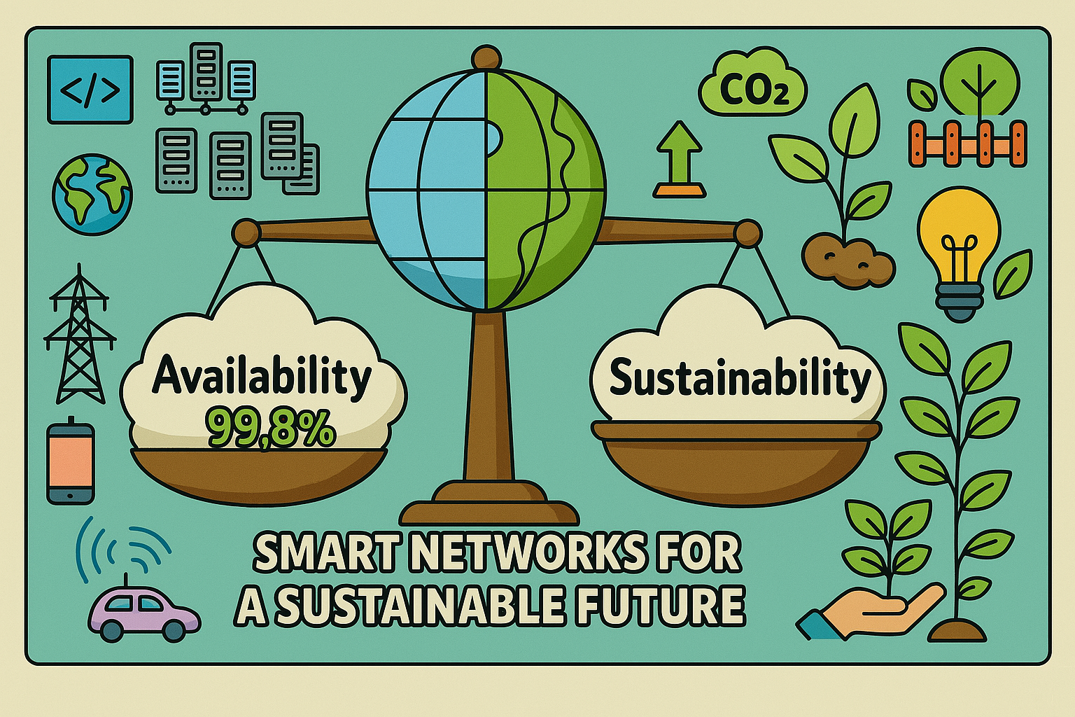

Slide 5
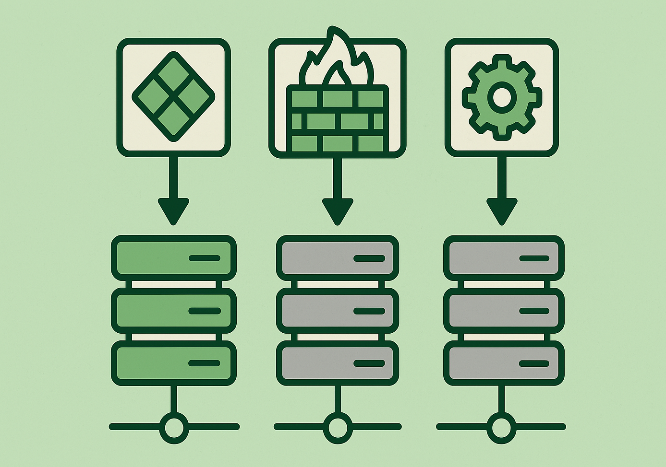

Slide 6
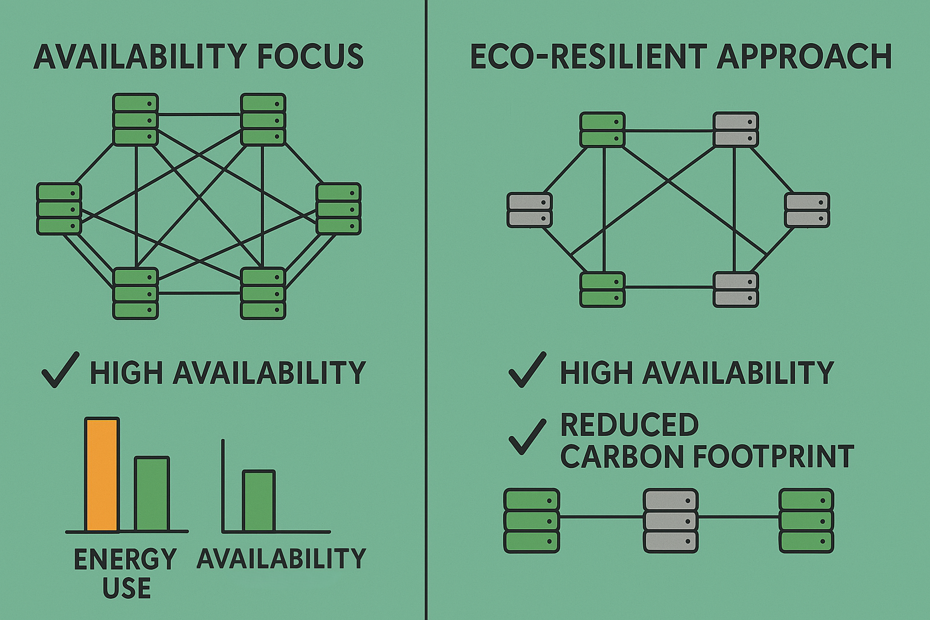

Slide 7


Slide 8

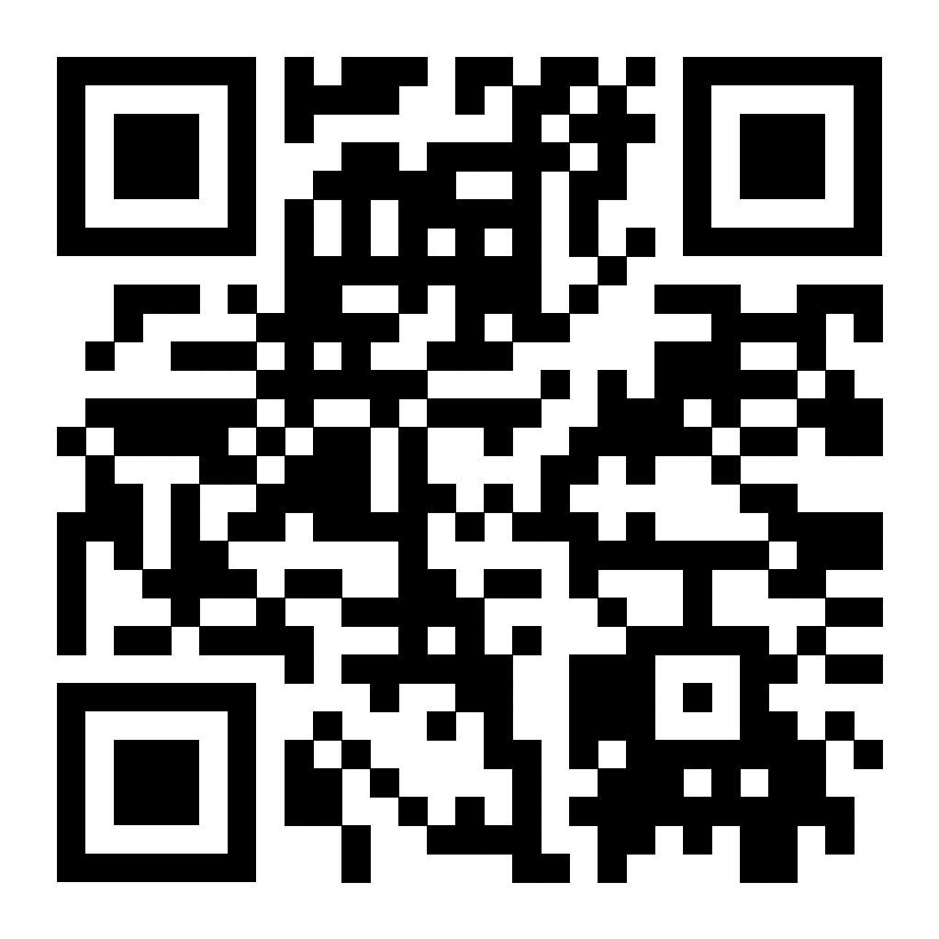
Thank You - Let’s Build Sustainable Networks!
Contact:
Email: msx044@uregina.ca
LinkedIn: https://www.linkedin.com/in/hamzashahab1610/
GitHub: https://github.com/hamzashahab1610
Project Link: https://github.com/hamzashahab1610/ENSE-805-Project-Eco-Resilient-Networks.git

